Slide 1
List of Contents
Updates for the assembly

Slide 2
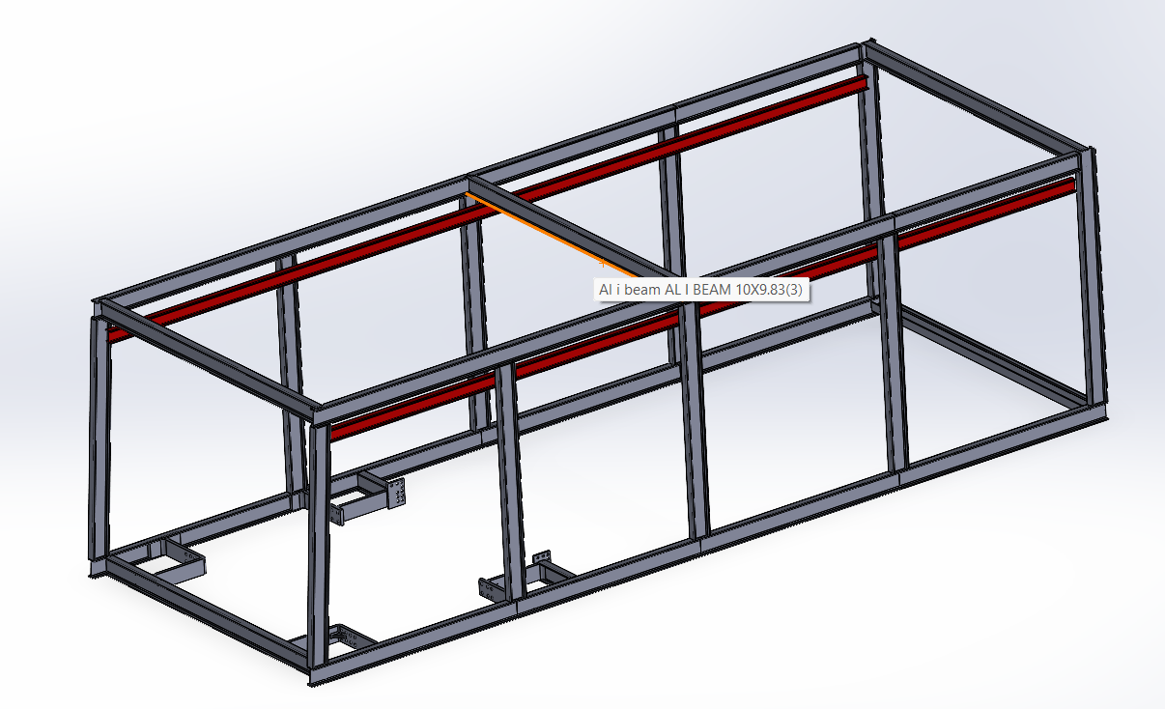
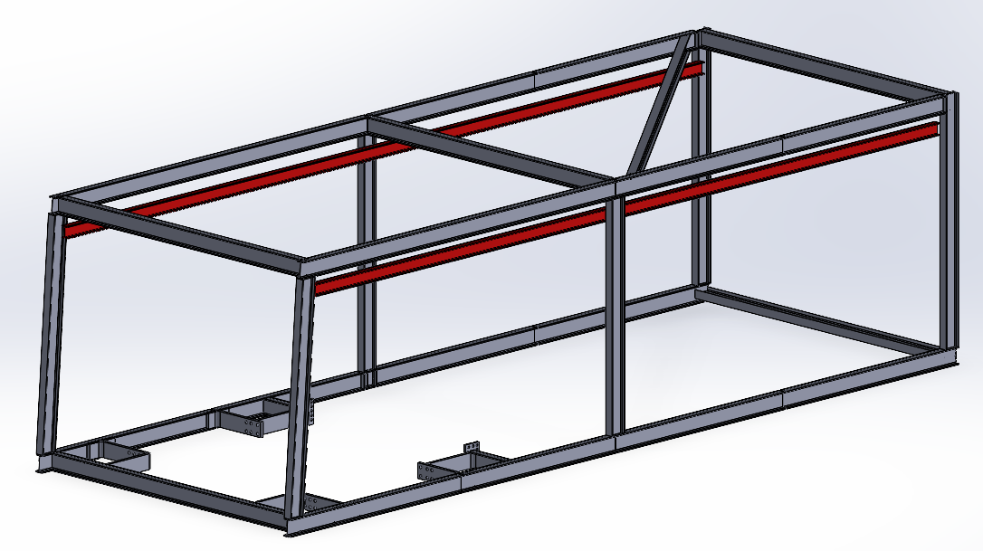
1. Updates for the assembly
New Frame steel structure versions
Version 1
Version
Weight: 8713 kg
Idea: more support to the side beams holding the crane
Weight: 5919kg
Idea: much more lightweight and integrating the support for the personnel on the roof BUT less support for the beams holding the crane

Slide 3
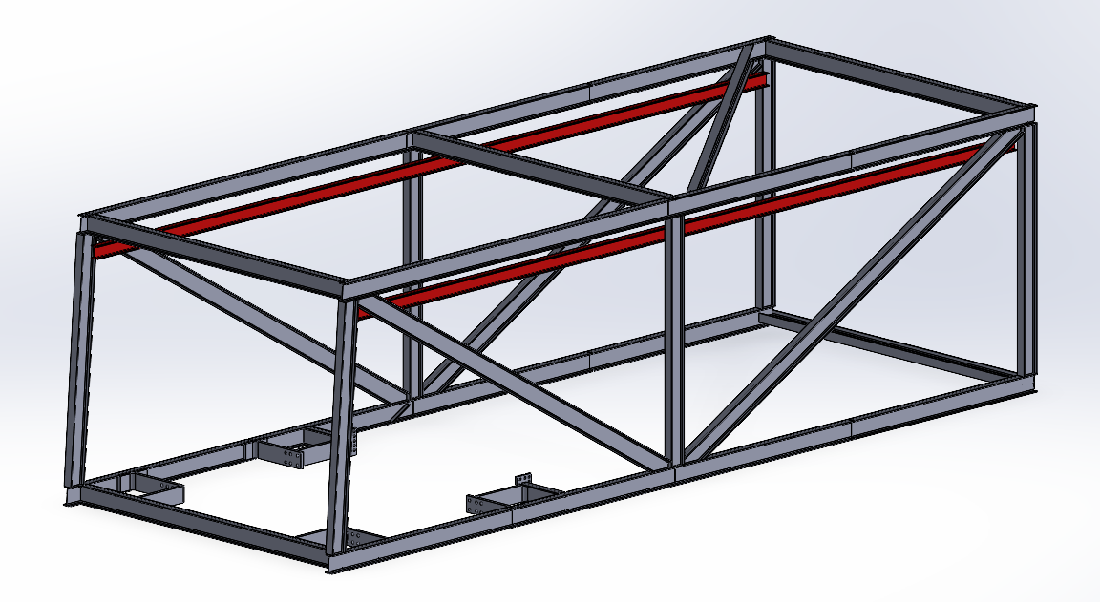
1. Updates for the assembly
New Frame steel structure versions
Version 1
Final decision:
Version 3 is probably the best combination among all the alternatives shown, therefore that will probably be the final decision.
Nevertheless, if any other remarks will be done about these new alternatives the for the beam structure, it will be readily changed
Weight: 7007 kg
Idea: idea in between the previous 2: still quite lightweight but higher support of the crane holding beams

Slide 4
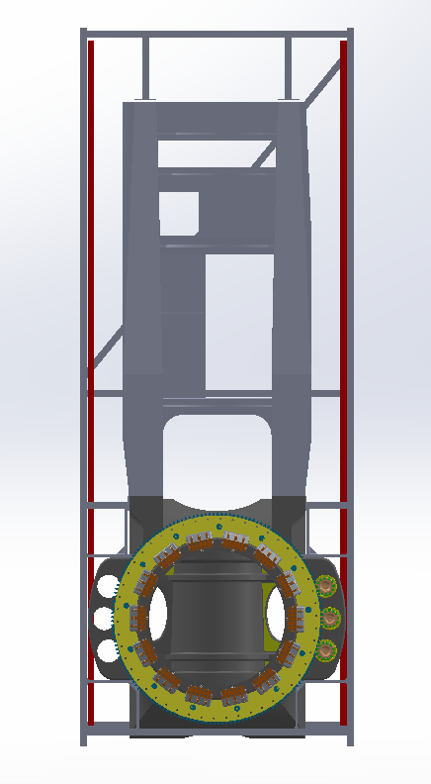
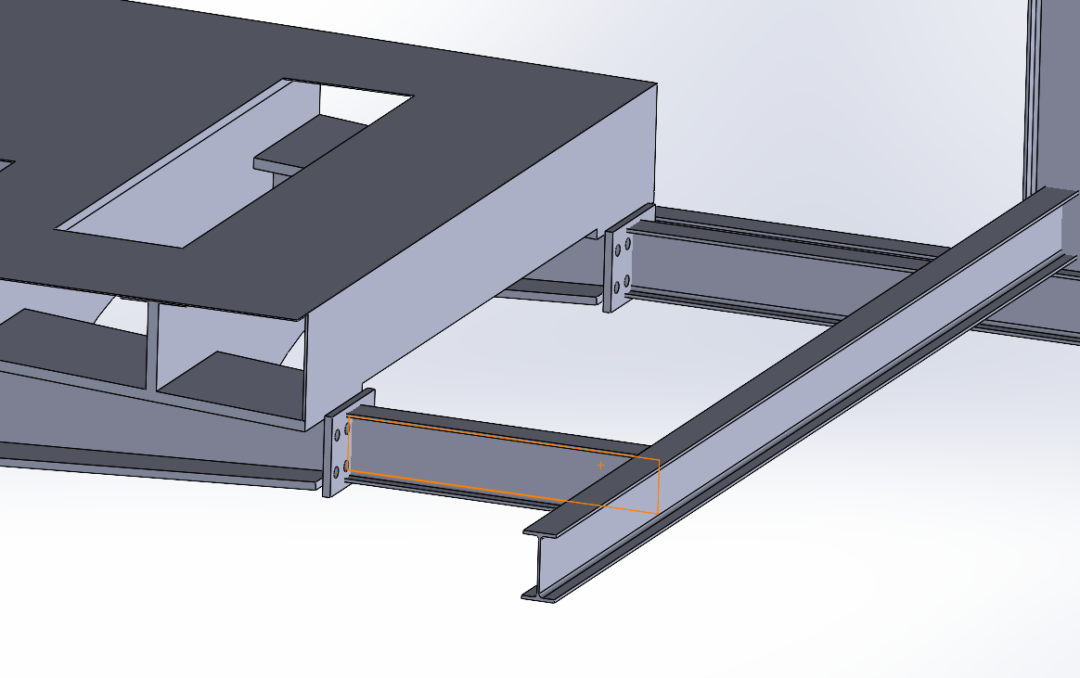
1. Updates for the assembly
Connection to the machine bed
1
Connection to the rear part
1
2
Idea:
Adding some reinforcements in the back that would give support for the axial loads.
Further improvements: add extra beam for lateral oscillation
3

Slide 5
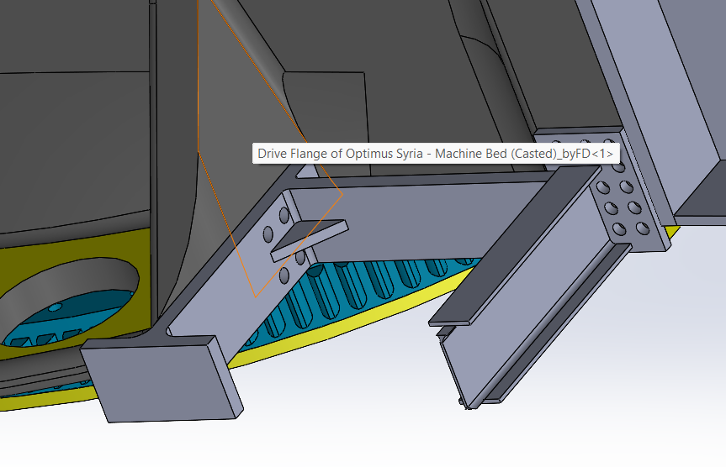
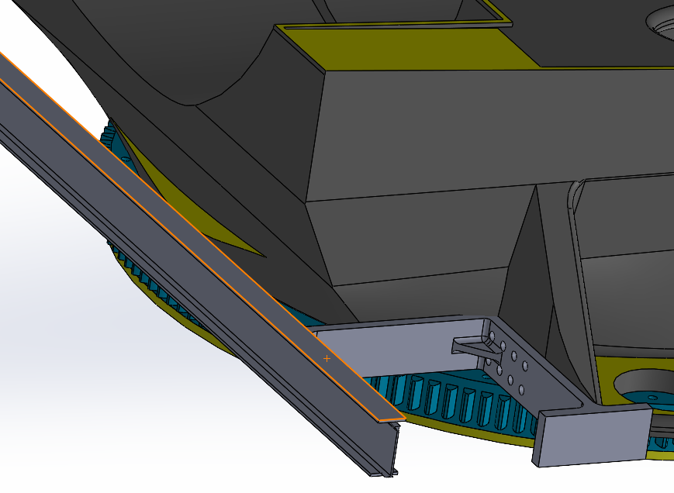
1. Updates for the assembly
Connection to the machine bed
Idea:
Adding a reinforced connection to the side beams (forming the structure) and a front beam that will be connected to the machine bed as well and damps also the axial loads
Further improvements: add the connection of the front beam
2
Connection to the Casted part: back
Idea:
Adding some beams that could be connected both directly to the bed and to the ribs on the flange support for the drives
Further improvements: solve the problems of the bolted connection of the machine bed parts and the bolts for the connection to the steel frame
3
Connection to the Casted part: front

Slide 6
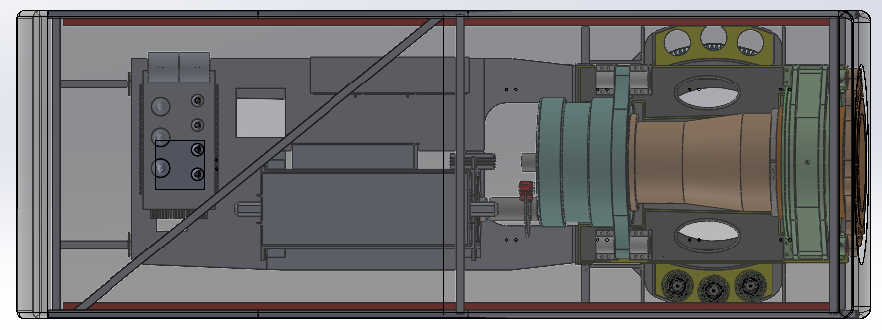
1. Updates for the assembly
New nacelle components arrangement
COULD EVEN BE REDUCED!
Components:
Shaft
Bearing
Gearbox
Brake & Coupling
Casted Machine bed
Welded Machine bed
Generator
Converter
Transformer
8
>1000 mm
2
9
3
1
700 mm
7
4
6
5
SPACE HAS BEEN OPTIMIZED!!!

Slide 7
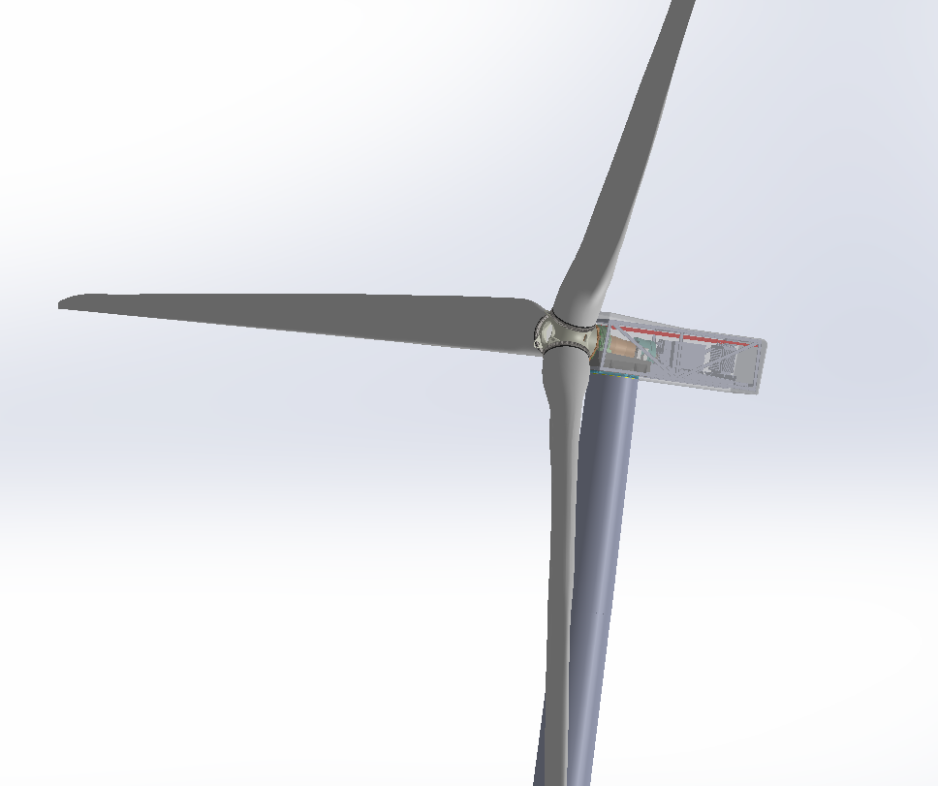
1. Updates for the assembly
Final assembly status
1
Still missing:
Hub Spinner
Cooling system
Crane
2
3

